Slide 1
Setting Up a Local WordPress Development Environment
844-ALT-HOST
By Gregory Young
Alternative Hosting
https://www.alternativehosting.com
support@alternativehosting.com
@AlternativeHost
https://www.facebook.com/AlternativeHosting

Slide 2
Limitations
You must be running:
Windows 7, 8 or 8.1, 64 bit
Linux, 64 bit
Mac OSX 10.8 or higher
You Will Need:
At least 2 GB of disk space
At least 512 MB free RAM
A working network connection with DHCP enabled

Slide 3
Step 1 – Download Virtual Box

Slide 4
Choose Your Platform

Slide 5
Install Virtual Box

Slide 6
Virtual Box is Now Installed

Slide 7
Step 2 – Download TurnKey Linux - WordPress

Slide 8
Extract the Virtual Machine

Slide 9
Create a New Virtual Machine

Slide 10
Select the Machine Options

Slide 11
Memory Size

Slide 12
Select the Hard Drive File You Extracted

Slide 13
Edit the Settings

Slide 14
Set Your Network to Bridged Adapter

Slide 15
Start Your Machine

Slide 16
Enter a root Password

Slide 17
Confirm the root Password

Slide 18
Set a SQL Password

Slide 19
Confirm the SQL Password

Slide 20
Set Your WordPress admin Password

Slide 21
Confirm Your admin Password

Slide 22
Enter Your admin E-Mail Address

Slide 23
Skip the Hub Services

Slide 24
Install the Updates

Slide 25
Updates Take a Few Minutes

Slide 26
Write This Down – The Address May Change

Slide 27
Quit the Console

Slide 28
Click “Yes”

Slide 29
On Boot You Will See the Server Address

Slide 30
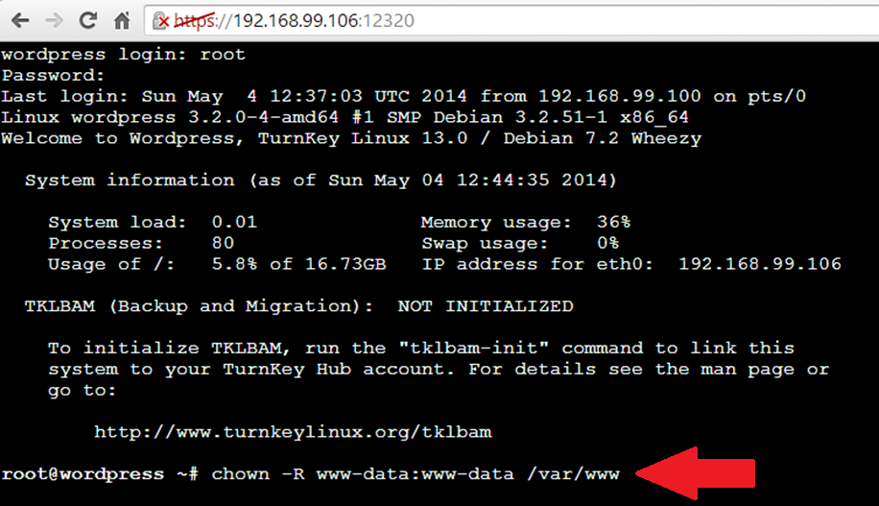
Open the Web Shell in your Browser Run the command “chown –R www-data:www-data /var/www”

Slide 31
Go to Your Site

Slide 32
Upgrade to WordPress 3.9 (or latest)

Slide 33
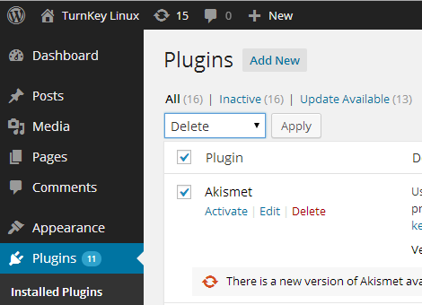
Delete the Included Plugins

Slide 34
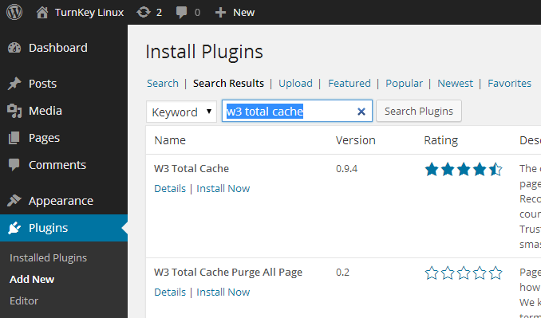
Install Your Plugins

Slide 35
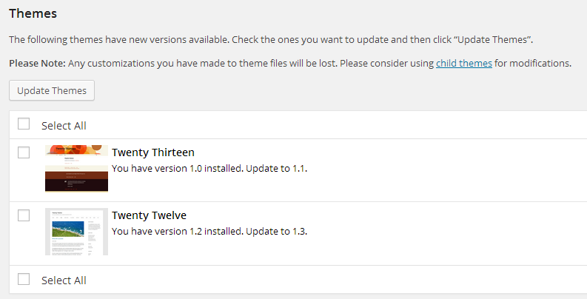
Update the Included Themes

Slide 36
Develop Your Site

Slide 37
Links
Virtual Box: https://www.virtualbox.org/
TurnKey Linux – WordPress Appliance http://www.turnkeylinux.org/wordpress

Slide 38
Questions?
https://www.alternativehosting.com
support@alternativehosting.com
1-844-ALT-HOST
@AlternativeHost
https://www.facebook.com/AlternativeHosting
@TheGregoryYoung
http://www.gregoryyoung.ca

